Slide 1
Basic Telecom – Ice Breaker

Slide 2
Objectives
At the end of this session, you will be able to:
  Understand a typical composition of systems available at any TELCO operator
  Locate the context of communication network in a TELCO stack
  Understand the difference between network element, network architecture and services
  Understand yesterday’s and today’s services
CONFIDENTIAL© Copyright 2008 Tech Mahindra Limited

Slide 3
Agenda
TELCO Operator stack
Telecom Business
Telecom Services: Yesterday and Today
CONFIDENTIAL© Copyright 2008 Tech Mahindra Limited
Notes:
TELCO : Telecom Company

Slide 4
What is Telecom Umbrella?
Business Intelligence, Portal, CRM, Rating, Billing Payments, Debt Management, Revenue Assurance, Fraud Management, Settlements
BSS
OSS
Order Management, Provisioning, Network Inventory Management
NMS
Fault Management, Performance Management, Mediation
Network
GSM, PSTN, Broadband, Cable, Satellite
We will concentrate on !!!
CONFIDENTIAL© Copyright 2008 Tech Mahindra Limited

Slide 5


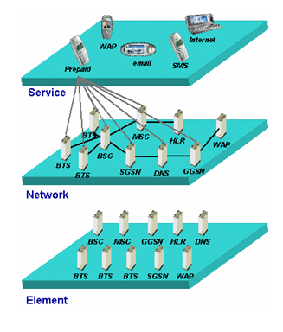








Telecom Business
$$
Service Providers
NE Suppliers
CONFIDENTIAL© Copyright 2008 Tech Mahindra Limited

Slide 6

Services Yesterday
End User Services
FAX
Connectivity Layer
VAS
Voice
SMS
CONFIDENTIAL© Copyright 2008 Tech Mahindra Limited

Slide 7



Services - Today and Tomorrow
End User Services
Messaging
Commerce Apps
Community Portal
ERP systems
Still Imaging
Video Streaming
Mail Services
VOIP
Content & Application Layer
FAX
Connectivity Layer
VAS
Voice
SMS
CONFIDENTIAL© Copyright 2008 Tech Mahindra Limited

Slide 8
Summary
In this session, we have learned:
  Typical composition of systems available at any TELCO operator
  Context of communication network in a TELCO stack
  Difference between network element, network architecture and services
  Yesterday’s and today’s services
CONFIDENTIAL© Copyright 2008 Tech Mahindra Limited
Notes:
TELCO stands for Telecom Company

Slide 9
Thank You

